Slide 1
DSC 530 Final Project
Caleb Corpuz
2020

Slide 2
Statistical Question
The question that I want to answer is how does the different fighting styles relate to each other. My hypothesis is that there would be a negative correlation between fighting styles. For example, if a fighter strikes more then they will have less takedowns or submissions.

Slide 3
Variables
avg_SIG_STR_landed
Double variable. Represents significant strikes landed per minute
avg_SIG_STR_pct
Double variable. Represents significant striking accuracy
avg_TD_landed
Double variable. Represents average takedowns landed per 15 minutes
avg_TD_pct
Double variable. Represents takedown accuracy
Winner
Binary variable. Indicates whether or not the fighter won the fight
Corner
String variable. Indicates which corner the fighter is fighting out of (red or blue).

Slide 4
Variable Analysis

Slide 5
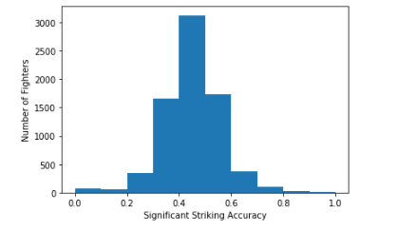
avg_SIG_STR_pct
The average significant striking accuracy is 0.4501. The mode of the significant striking accuracy is 0.46. The spread of the significant striking accuracy is 0.0125. The extreme values, or outliers that we see show a significant striking accuracy of 0 and 100 %. In mixed martial arts this can make sense. A fighter may have a fighting style that favors take downs and submissions so they don’t throw any strikes or maybe the fighter only works on strikes leading to a 100% striking accuracy.

Slide 6
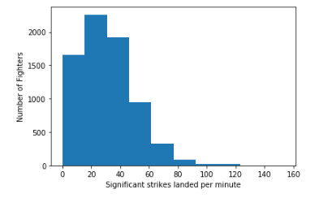
avg_SIG_STR_landed
The average significant strikes landed 30.5637. The mode of the significant strikes landed per minute is 0.0. The spread of the significant strikes landed per minute is 383.9136. For the outliers, we follow the same thinking that different fighting styles can result in the extreme values for this variable.

Slide 7
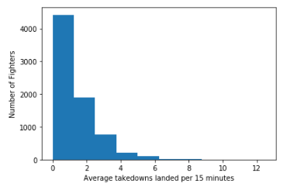
avg_TD_landed
The average of the average takedowns landed per 15 minutes is 1.277. The mode of the average takedowns landed per 15 minutes is 0.0. The spread of the average takedowns landed per 15 minutes is 1.607. At this point you may find it odd that some of these variables have a mode of 0. In fighting this is a very realistic value. Fighters may take a defensive approach so that they don’t do anything to risky. While this can be boring for the fans it is a common occurrence in this sport.

Slide 8
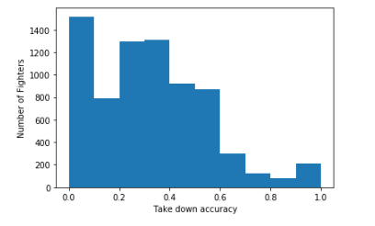
avg_TD_pct
The average takedown accuracy is 0.3157. The mode of the takedown accuracy is 0.0. The spread of the takedown accuracy is 0.0547.

Slide 9
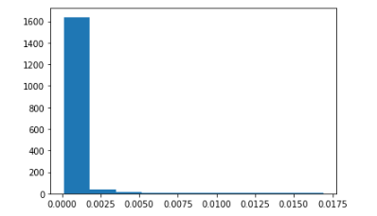
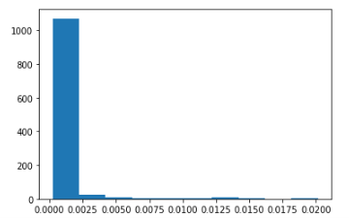
Probability Mass Function for avg_SIG_STR_pct
All fighters
Only fighters that won the fight

Slide 10
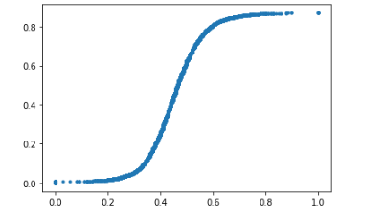
CDF for avg_SIG_STR_pct
This shows that the variable is normally distributed

Slide 11
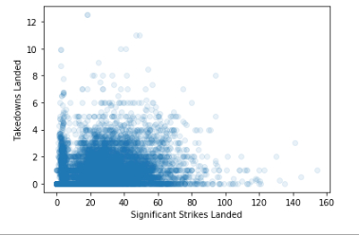
avg_SIG_STR_landed and avg_TD_landed
The Pearson correlation coefficient is 0.03651250484035231 meaning it has a very small positive correlation.

Slide 12
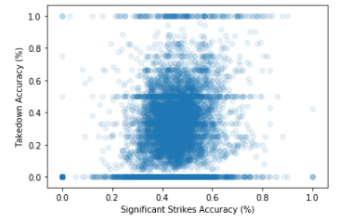
avg_SIG_STR_pct and avg_TD_pct
The Pearson correlation coefficient is 0.16668533445617667 meaning there is a small positive correlation.

Slide 13
Addressing the Statistical Question

Slide 14
Statistical Question
To revisit the hypothesis, there is a negative correlation between fighting styles. For example, if a fighter strikes more then they will have less takedowns or submissions.

Slide 15
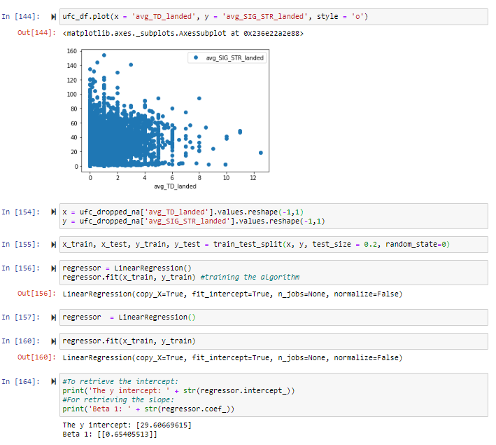
Linear Regression and Hypothesis Conclusion
The beta values show that when significant strikes landed increases by 1, takedowns landed increases by 0.65. One explanation for this could be that when a fighter gets hit with more significant punches, they become more vulnerable to takedowns. I initially thought that there would be a negative correlation because I assumed that if you were able to land more significant strikes then you would stick with that fighting style rather than go for a takedown.

